Slide 1
Tic-Tac-Toe
Soham Purandare

Slide 2
Background
Computer science major
Graduating this semester
Interests
reading books
solving challenges/puzzles like Rubik’s cube, Sudoku etc

Slide 3
Considered options
Since the problem set is specific and very obviously a case to be solved with the minimax algorithm, it has been the sole approach towards solving the tic tac toe in a way that the computer tries to win every time.

Slide 4
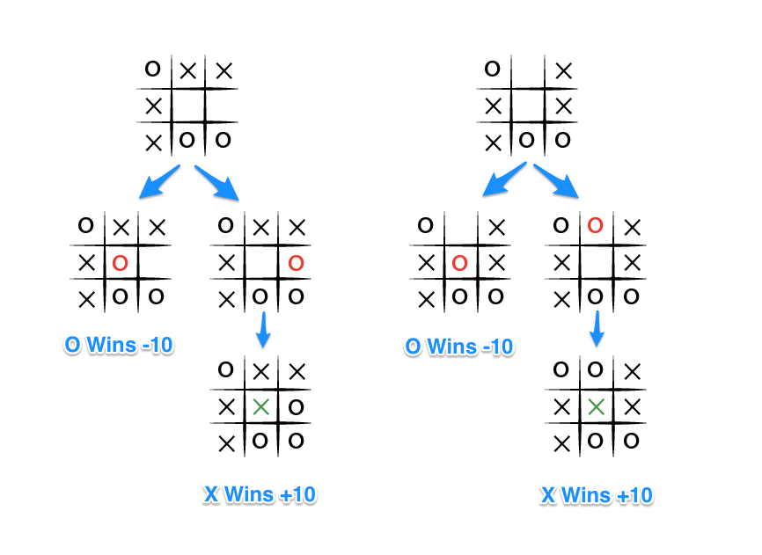
Solution Approach
Minimax algorithm

Slide 5
PEAS
Performance measure: not letting the player win
Environment:The 4x4 Tic-Tac-Toe grid
Actuators: Mouse clicks

Slide 6
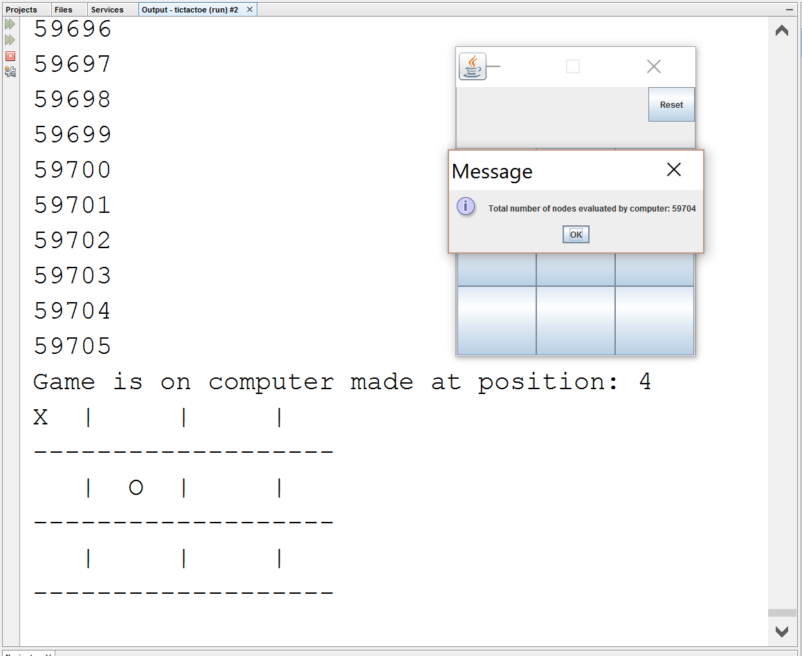
Final outcome

Slide 7
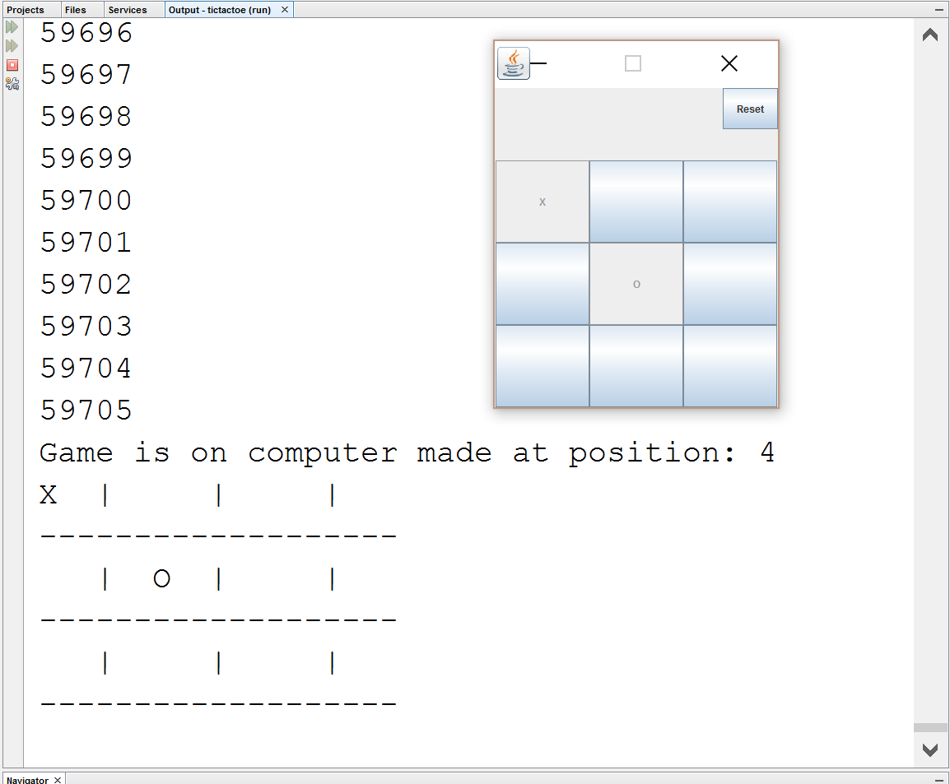

Slide 8
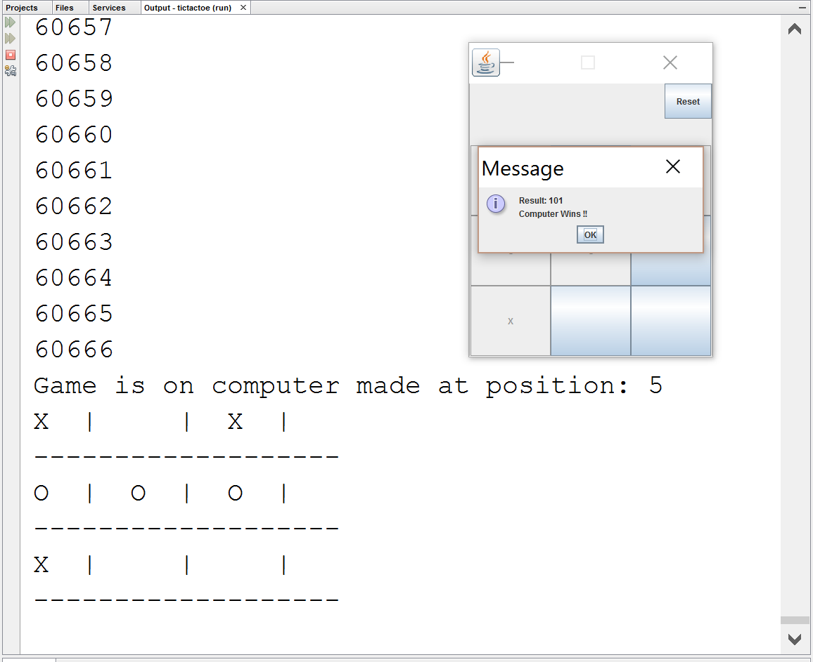

Slide 9
Thank You

